Slide 1
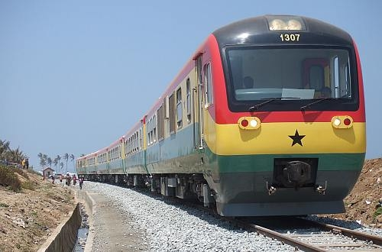

RAILWAY DEVELOPMENT IN GHANA
AN OPPORTUNITY YOU CANNOT MISS
Presentation By CERATH INVESTMENTS
www.cerathinvestments.com

Slide 2
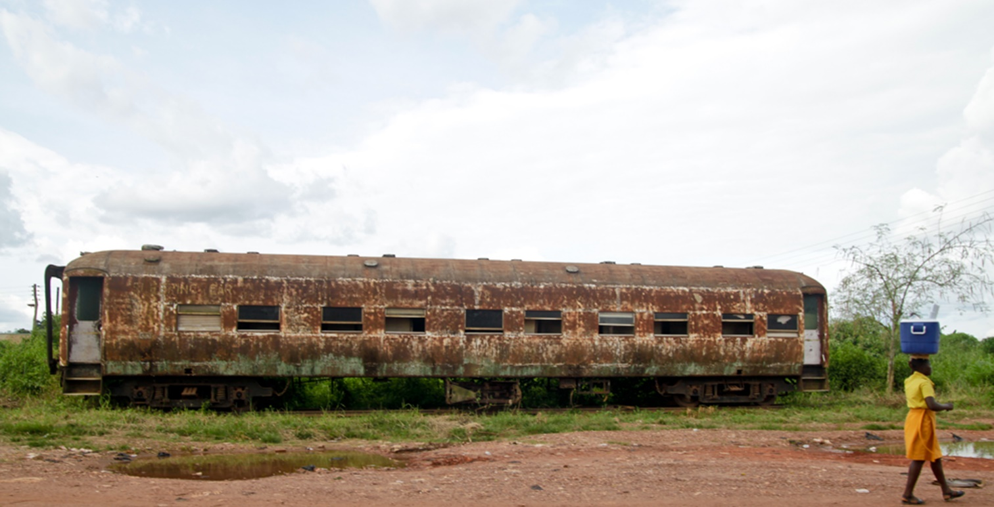
Current State of Ghana’s Railway
Ghana’s current railway systems is about 940 Km
Less than 13% is operational
Government of Ghana is seeking to revive the railway sector

Slide 3
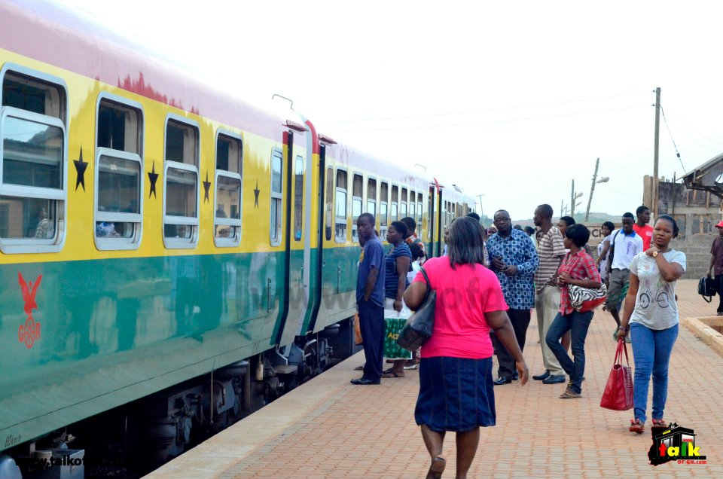
Railway Master Plan of Ghana
Government of Ghana has developed the Railway Master plan
The plan seeks to achieve two main things
Rehabilitate old railway lines
Build new railway systems connecting the whole nation.

Slide 4
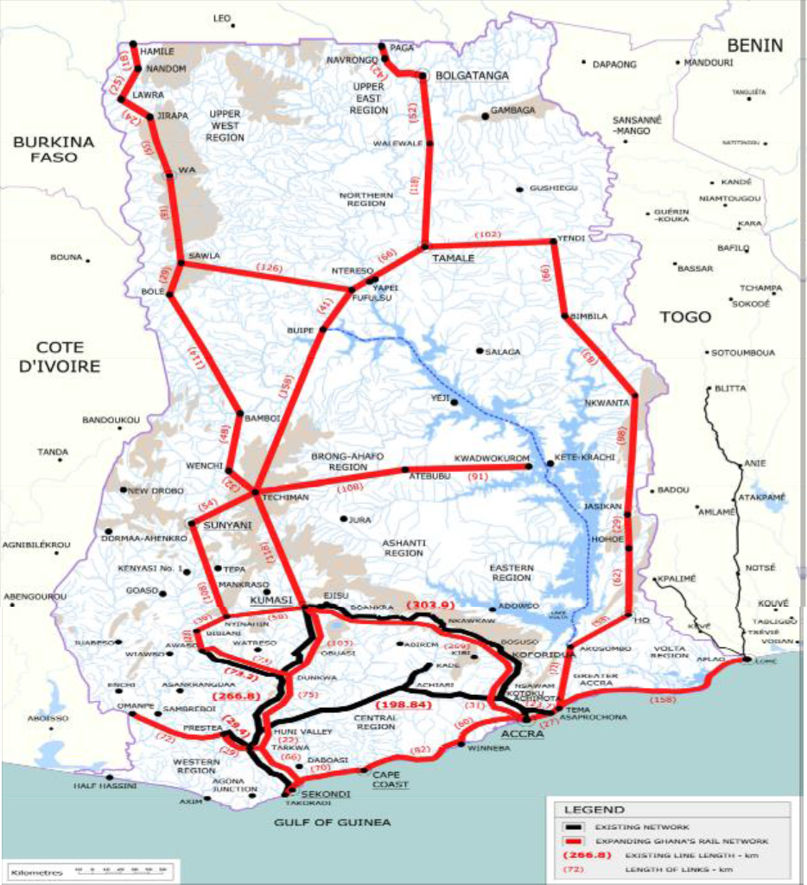
Railway Opportunity
Black Line- Existing Railway systems
Red Line- Proposed New Railways

Slide 5
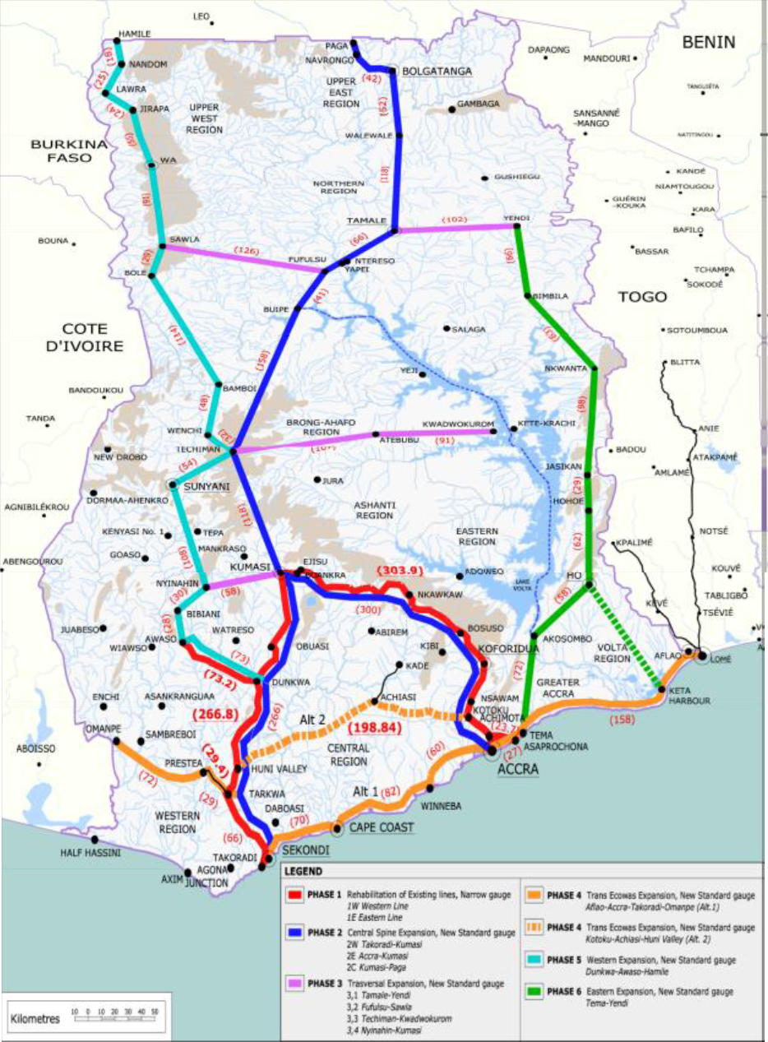
Railway Development Phases
Distances of the various phases has been explained in the next slide

Slide 6
Summary Box for Railway expansion phases

Slide 7
Government of Ghana for Railway Investors
Government of Ghana has established a Ministry of Railway Development & Ghana Railway Development Authority.
Government of Ghana is willing to partner investors to develop Ghana’s railway
Government of Ghana is willing to consider several business models for development including Build, Operate and Transfer (BOT)
Government of Ghana will provide incentives for Railway investors

Slide 8
CERATH Investments’ Role
CERATH is a firm aimed at facilitating investments and development projects to Ghana. Our vision is to make Ghana a home for foreign investors. Our mission is to facilitate investments into strategic areas of Ghana’s economy.
CERATH will support investors with
Required research for investments
Connections to governments and other stakeholders
Support to attain permits, certifications and registrations
Support in long management of investments
WWW.CERATHINVESTMENTS.COM

Slide 9


