Slide 1
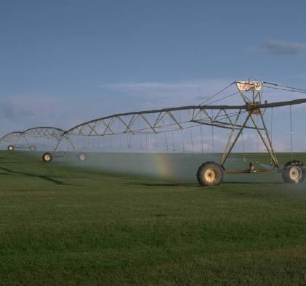
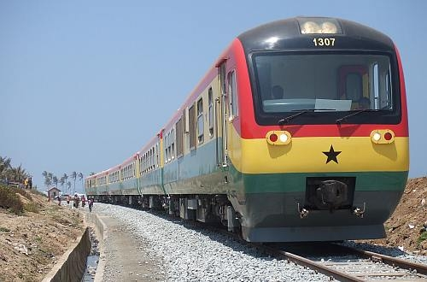
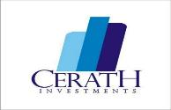
CERATH INVESTMENTS
DEVELOPMENT THROUGH STRATEGIC INVESTMENTS
www.cerathinvestments.com

Slide 2
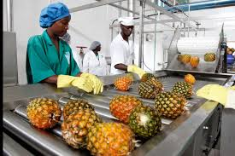
ABOUT
CERATH is a firm aimed at facilitating investments and development projects to Ghana.
Vision
Our vision is to make Ghana a home for foreign investors.
Mission
Our mission is to facilitate investments into strategic areas of Ghana’s economy.
Staff
CERATH is currently a team of 8 ( Partners & Associates)

Slide 3
KEY SERVICES
Projects development particularly in the area of agriculture, transportation and construction
Business Research
Facilitate Public-Private partnership
Independent monitoring and evaluation of projects

Slide 4
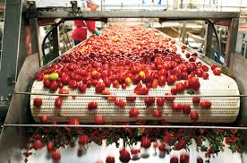
CURRENT PROJECTS
Reviving Northern Star Tomato Factory- CERATH has partnered with Thucer Agro ( South Africa) with the aim of reviving NSTC under an integrated business model to process fruits and vegetables
Railway Development-CERATH has partnered with China Railway Eryuan Engineering Corporation in the implementation of Railway in Ghana.
GrainVeg Project- CERATH seeks to establish 1000 acres commercial farm under modern irrigation equipment

Slide 5
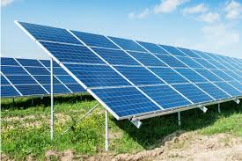
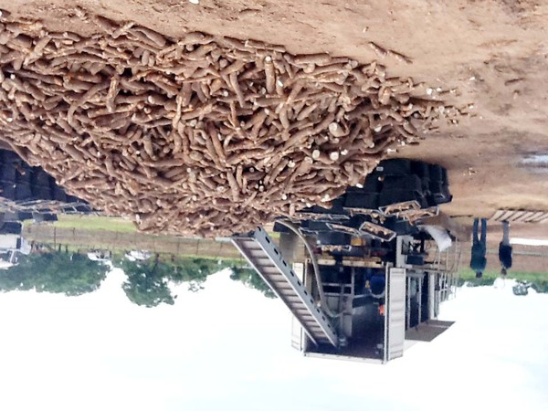
Areas of Interest
Agriculture & Agro Processing
Infrastructure Development
Energy

Slide 6
Areas of Interest
Agriculture and Agro Processing
Interested in large scale commercial agricultural initiatives
Processing and value addition of agricultural products ( fruits, vegetables…)
Improving untapped agricultural potentials ( sorghum, tomatoes, strawberries)
Infrastructure
Interested in railway development
Developing Ghana’s untapped water transportation systems
Energy
Interested in partnership with large energy actors to serve as Independent Power Producers

Slide 7
Mode of Operations
Our mode of operation is based on partnership with relevant stakeholders
Due to our mission to enhance foreign direct investments, we work extensively with foreign mission
Our approach is to take every investment opportunity on a case by case basis.

Slide 8
Our Story of Opportunities
Agriculture
Northern Ghana alone has 6 million hectares of arable land
Local demand value ($) for rice (600m), sugar ( 400m)
Cotton production in Northern Ghana alone is 55,000 MT annually
Cold chain industry estimated at $400 million annually
Market demand for logistics huge- tractors estimated at $800 million
Infrastructure
-Railway opportunity is estimated at 4200km worth $2.1 billion
Housing needs of 1,700,000 units
Untapped water land transportation system particularly on the Volta Lake for transportation of goods from the breadbasket regions

Slide 9
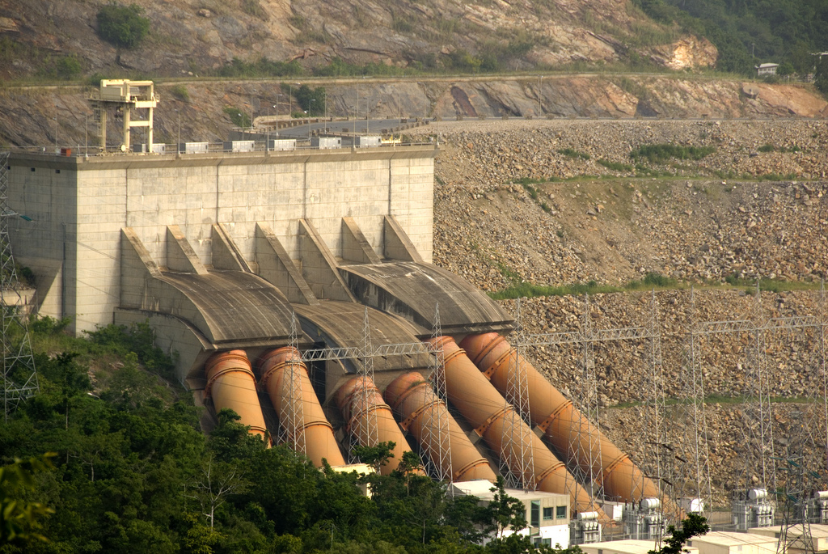
Our Story of Opportunities
Energy
Power crises cost the nation $2.1 million every day
Plan is to institute new power projects
2017 target is to add 1200 MW to current capacity
Potential for massive solar energy production in Northern Ghana.
Potential for geo thermal and tidal wave

Slide 10
A Growing Positive Business Climate
The current economic climate in Ghana is one aimed at boosting local production, industrialization and job creation. This is manifested in
New initiatives- One District, One Factory , One Village, One Dam, Planting for Food and Jobs
Tax incentives
Creation of sector ministries and portfolios- eg. Railway ministry
Increasing target of FDI from $3 billion ( 2016) to $5 billion ( 2017)
More importantly, private sector considered as the engine of growth

Slide 11
Why CERATH Investment?
Diversified and experienced team
Connections and partnership with relevant government agencies and personnel
In-depth understanding of the Ghanaian system
Involved in many agricultural initiatives in Ghana
Well equipped to support investors’ activities
The vision of CERATH is supported by National government.

Slide 12
Essence of meeting
Introduce CERATH Investments and our work
LEARN about the strategic areas of interests of the Hungarian Embassy/Hungarian government in Ghana
Explore areas of partnerships
Linkages with investors
Explore insights of setting up Central European representation in Hungary

Slide 13
Thank You

