Slide 1
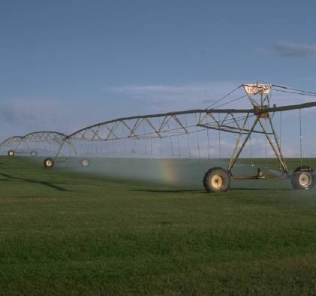
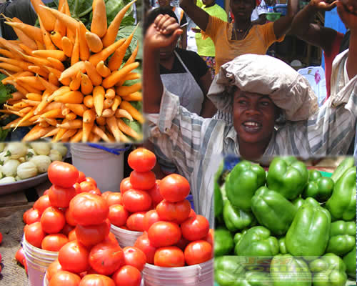
INVESTING IN GHANA’S AGRICULTURE
PRESENTATION BY CERATH INVESTMENTS
www.cerathinvestments.com

Slide 2
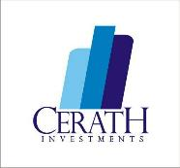
Introduction
Ghana’s agriculture based economy is the 4th and 7th biggest in West Africa and Africa respectively
Northern Ghana is known as part of the bread basket regions of Ghana
Endowed with 6.1 million hectares of arable land ( only 1.5 million used)
Has several river systems that allows bountiful supply of water
Comparative advantage in the production of cereals, legumes, vegetables and cash crops
Low human density , thus allowing agricultural expansion
Has the capacity to produce more than 60 percent of Ghana’s agricultural needs for both domestic and industrial use

Slide 3
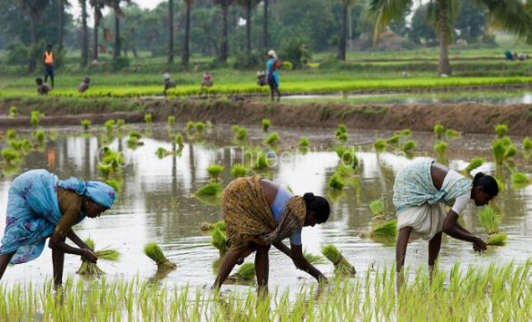
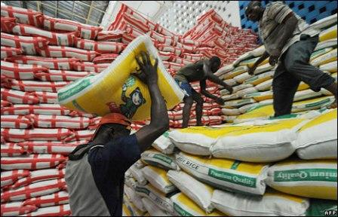
Statistics on Food Production Gap
The current rate/volumes of food importation are opportunities Northern Ghana can tap into
Ghana currently spends about US$600m annually to import rice
US$400m annually to import sugar, tomatoes etc
The importation of vegetables is estimated at $85 M annually.
$ 5 M dollars for onion importation to Ghana from Burkina & Niger
The market for soya is about 300,000 MT to 400,000 MT whilst the local production is less than 100,000 MT.
10,000 MT each of both maize and sorghum needed, which is projected to increase to10,000 MT ( A case of Guinness Ghana alone)

Slide 4
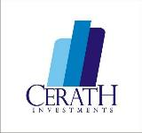
Agricultural Value Chain Opportunities
Rice – market opportunity worth over $600m
Soya- Local demand for soy is 400,000 MT, less than 100,000 MT produced in view of growing demand from poultry industry
Onions & Tomatoes- tomato and onion supply gap of 201 511 MT worth $110m
Groundnuts- Market gap of 177 355 MT worth $320m
Certified seeds- Supply gap of 44 639 MT of improved seeds worth $ 63.8m
Maize- Potential due to growing market and brewery industry
Sorghum- Growing market demand in view of its usage among local breweries
Sources: FinGAP Project & MADE Project

Slide 5
Other non-production opportunities
The focus here will be on logistics aimed at linking agricultural production areas in Northern to southern Ghana.
The overall logistics market gap is valued at $157m
Transportation or fleet management, maintenance, and warehousing activities
Market gap of 23 550 tractors worth a market of over $ 800 m
Sources: FinGAP Project & MADE Project

Slide 6
Returns on Investments
Tractor market- 36% within 3-5 years
Groundnuts- 32% within 3-5 years
Certified seeds- 33% within 3-5 years
Rice- 58% within 3-5 years
Logistics- 40% within 3-5 years
Tomatoes and onions- 52% within 3-5 years
Sources: FinGAP Project & MADE Project

Slide 7
Incentives for Private Sector Investments
Production
Customs exemption on imports of agricultural plants , machinery and equipment
5-10 years on cash crops production
Income tax exemptions for select farming activities and ~90% corporate tax exemptions for farmers outside of Accra
Agro-Processing
-5-year tax holiday from the establishment of the business and a 3-year corporate tax freeze
-50% tax rebates for agro-processing and manufacturing industries located in regional capitals and districts outside of Accra
NB: Special Taxes can be negotiated based on project’s nature

Slide 8
Government Initiatives
The government of Ghana is instituting initiatives to support investments
One district , One factory – aimed at establishing at least 216 agro processing factories across the nation.
Planting for Food and Jobs- A nationwide program aimed at boosting agricultural production
One Village, One dam policy – A policy aimed at building irrigation facilities to support agriculture
SADA Land Trust – securing lands for investors
Favourable attitudes towards public- private partnership

Slide 9
Investing in Ghana’s Agriculture ( Summary)
Significant amount of land and water resources
2. Active population as labour force
3. Favourable tax regimes/incentives for agricultural activities
4. Significant programs and initiatives to support investments
5. CERATH experience and team to support

Slide 10
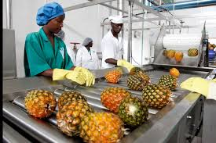
Background Of CERATH
CERATH is a firm aimed at facilitating investments and development projects to Ghana.
Mission
Our vision is to make Ghana a home for foreign investors.
Vision
Our mission is to facilitate investments into strategic areas of Ghana’s economy.
Representations in:
Ghana
Netherlands
China

Slide 11
Why CERATH Investment?
Diversified and experienced team
Connections and partnership with relevant government agencies and personnel
In-depth understanding of the Ghanaian system
Involved in many agricultural initiatives in Ghana
Well equipped to support investors’ activities
The vision of CERATH is supported by National government.

Slide 12
CERATH’s support
Assistance in developing the project concepts- bridging Ghanaian situation and investors’ interests.
Business viability assessments
Supporting in attaining permits and certifications
Facilitate Public-Private partnerships
Joint Ventures Formation to launch projects
CERATH is interested in a minimum investment of $5 million

Slide 13
Contact
Ghana Representative
Paa Kofi Osei-Owusu
Email: pkoseiowusu@gmail.com or cerathgroup@gmail.com or paa@cerathinvestments.com
Tel: +233 (0)209244168 ( Ghana)
Skype:pkoseiowusu
Website: www.cerathinvestments.com
International Representative
Name; Lucille Abruquah
Email: labraquah@yahoo.com or cerathgroup gmail.com or labraquah@cerathinvestments.com
Tel: +8615881013942 (China)
Skype: lucillexoxo
Website: www.cerathinvestments.com

